Slide 1

Case Study on Forecasting Stock Prices for Industrial Production- Frozen food , Ice Cream and Desserts in US

Slide 2
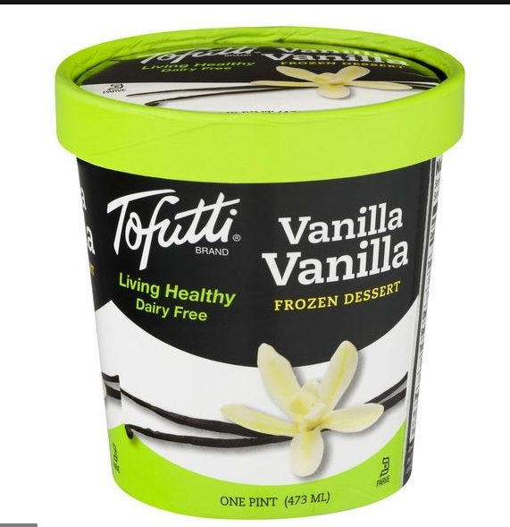
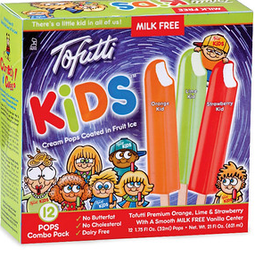
INTRODUCTION
Ice cream is a sweetened frozen food, commonly made of milk fat, milk protein, cream, and is flavored using sweeteners such as sugar, or sugar alternatives, and toppings such as cocoa or vanilla. Ice cream itself forms about 60 percent of the frozen dessert market, alongside confectionary items, frozen yogurt and candies. This case study revolves around the demand for Ice cream in US. At start of 2020 there was a crisis of supply and demand. Due to pandemic certain items were in high demand. We will look how the demand for ice cream was in this period.

Slide 3
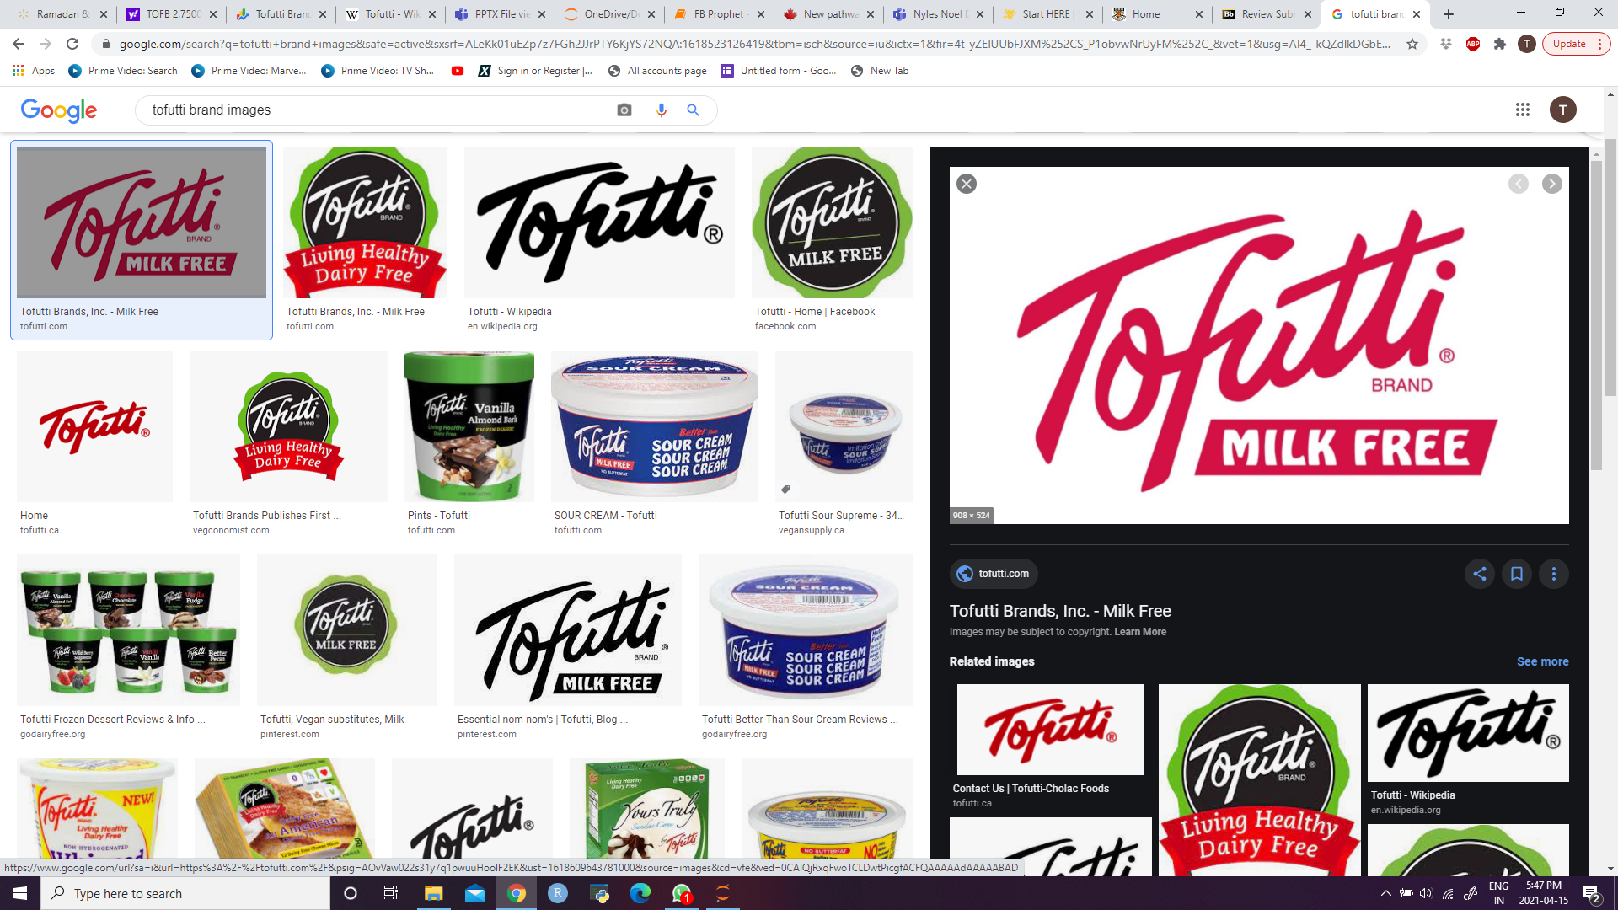
TOFUTTI BRANDS INC.
The company engages in the development, production, and marketing of dairy free, vegan frozen desserts, cheese, and other food products under the TOFUTTI brand in the United States and internationally.
It offers frozen desserts, including frozen sandwiches and chocolate-coated crispy cones, bars, dairy free vegan cheese products, such as cream cheese, sour cream, cheese slices, and dairy free ricotta cheese alternatives; spreads; and frozen food products comprising frozen crepes.
The company sells its products through independent unaffiliated food brokers to distributors, as well as on a direct basis to retail chain accounts or to warehouse accounts that directly service chain accounts. Tofutti Brands, Inc. was founded in 1981 and is based in Cranford, New Jersey.
STATISTICS TODAY – TOFB
OPEN- $2.8100
LAST CLOSING- $2.750
Market Cap- 14.173M
http://www.tofutti.com

Slide 4
Overview of Ice cream market size
The global ice cream market was worth an estimated USD 61 billion in 2019, growing at 5 percent during the forecast period 2016-2020.
The growth of the ice cream industry is driven by the demand for various flavors and types of ice cream, that come at various price points. The rising income levels in regions like APAC (Asia-Pacific) is expected to drive the growth of the ice cream market in that region, while the preference for healthy, nutritional, and premium-priced ice-cream are expected to drive the demand and growth in developed regions such as North America. and Europe.

Slide 5
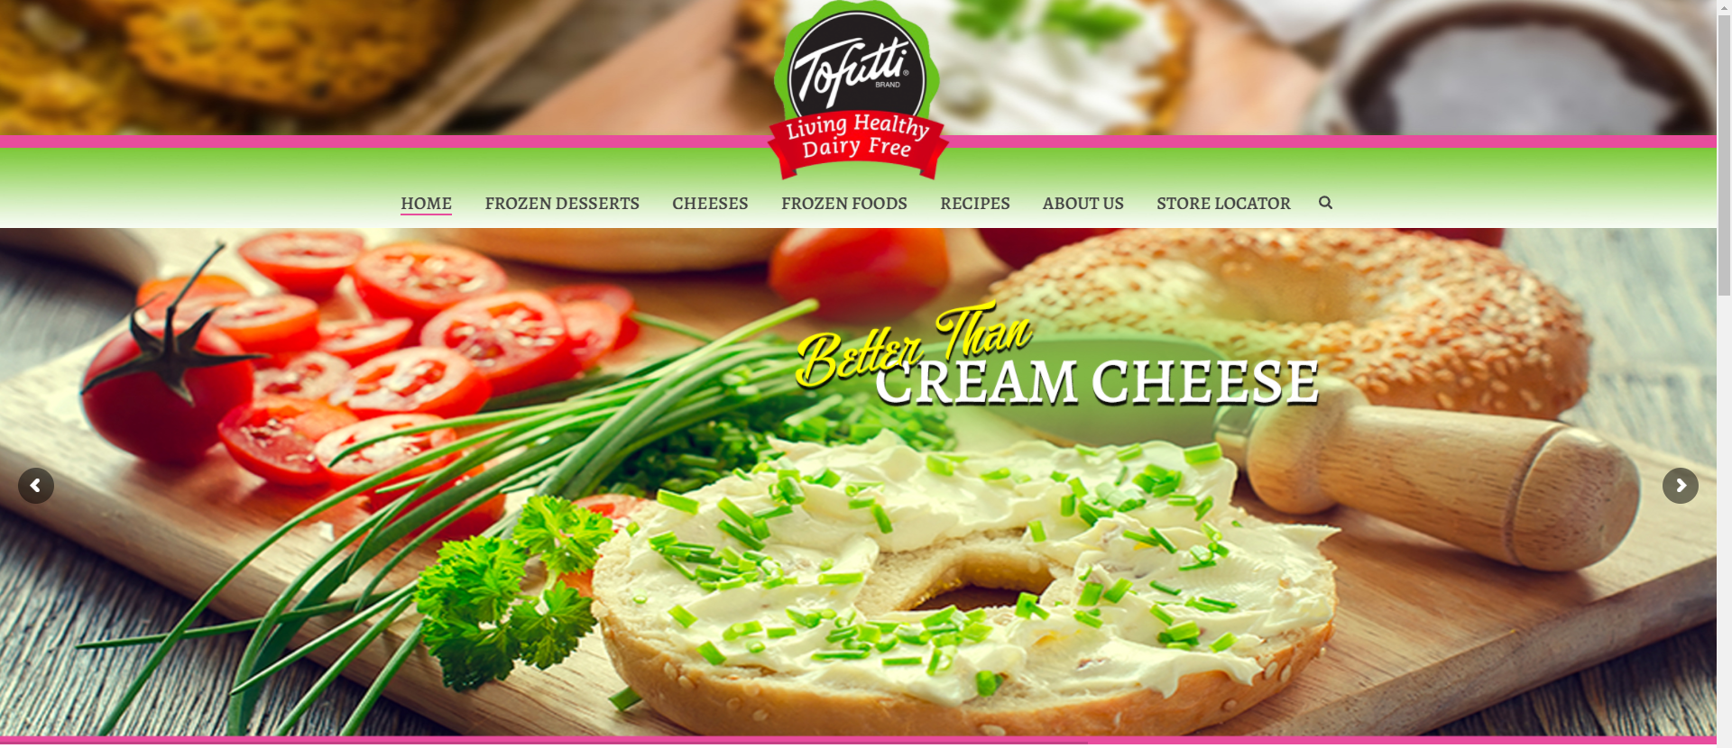
Problem Statement
The project focus arises as we are moving towards a customer sensitive world, we can study the Ice-cream demand is huge and may be affected.
Underlining the topic, we predicted stock pricing for a US based corporation – Tofutti Brands Incorp. selling an ice cream substitute for lactose-intolerant, kosher, food allergy free, vegetarian, and from raw vegan markets. Since the industry is growing well and about 70% of world population is believed to be lactose intolerant we will study if the sensitive population tends to fall towards healthy products or not, studying and predicting the fluctuations in Stock Prices of the Brand.

Slide 6
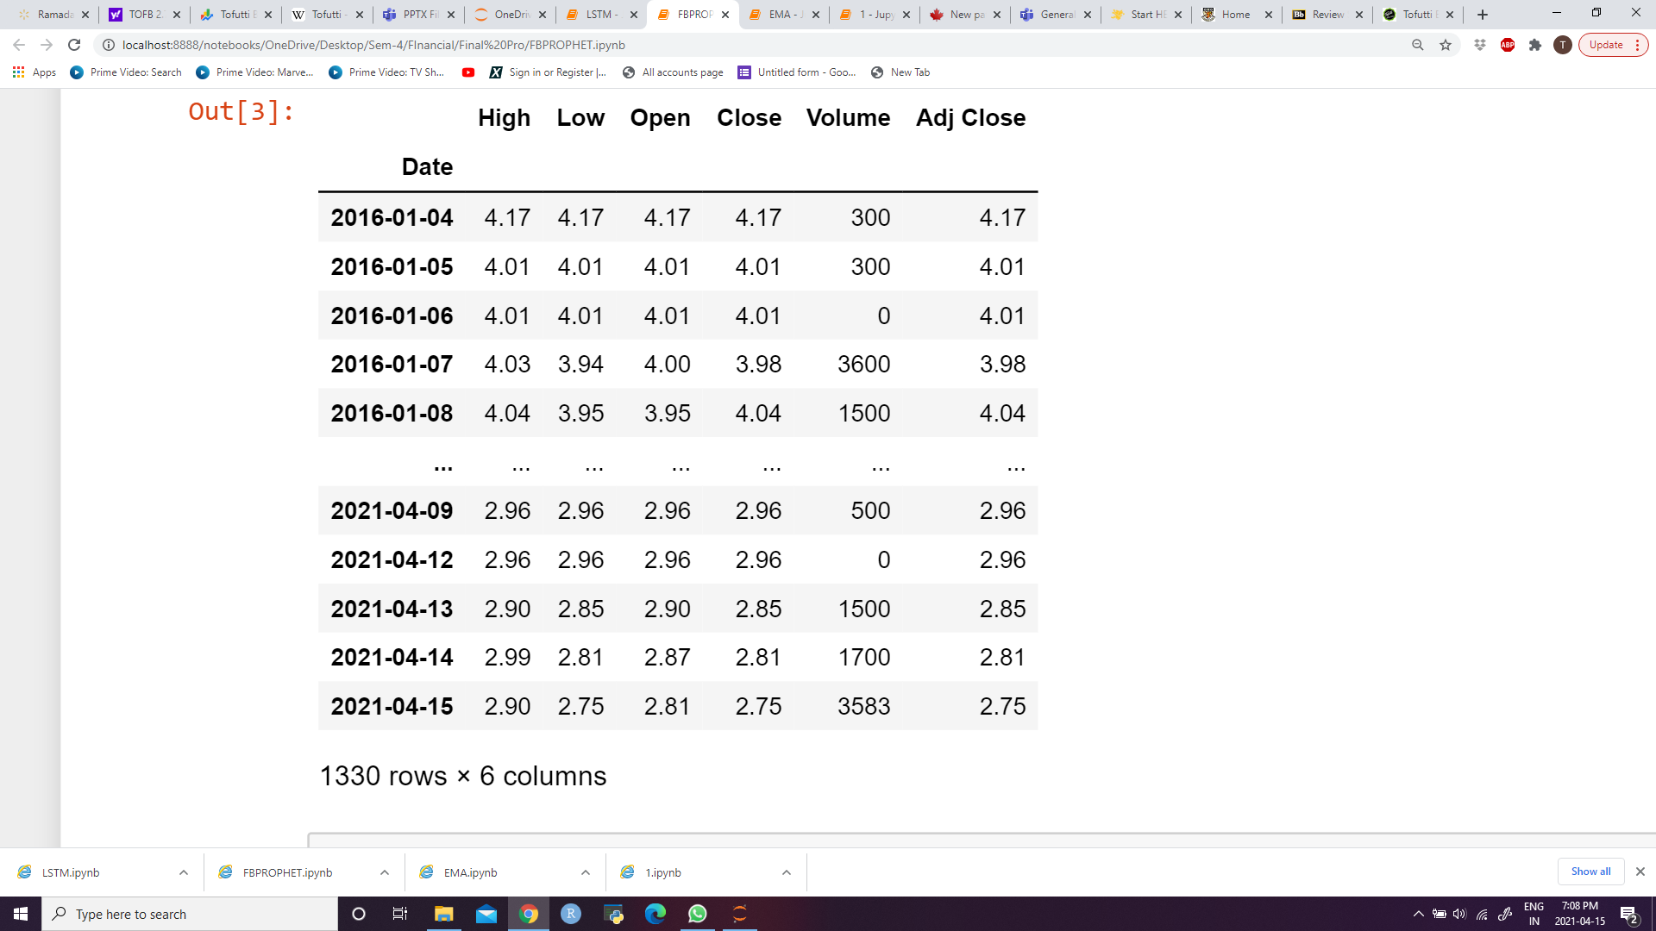
DATA
Data consists of 2 columns- Date and Closing Price each day.
Closing price is the last price at which the stock traded during a regular trading day and is the standard benchmark for studying stock performance over time.
Our Forecasting methods will help us study the fluctuating stock market of dairy, frozen and dessert industry in focus to moving towards a healthy lifestyle.
References: https://ca.finance.yahoo.com/quote/TOFB?p=TOFB

Slide 7
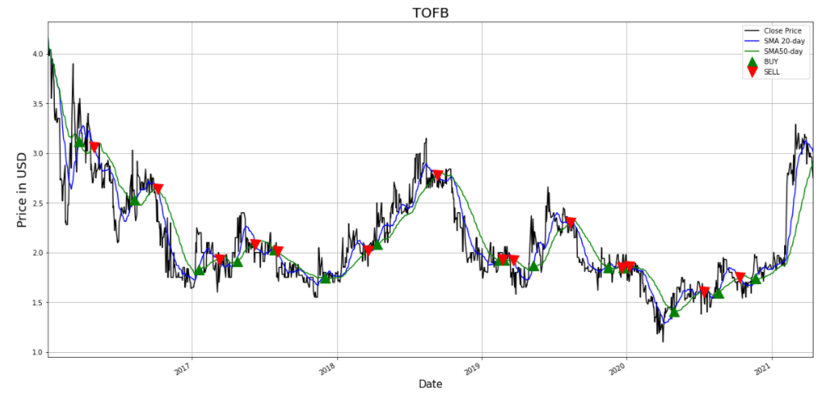
Simple Moving Average
Simple Moving Average method assigns equal weights (1/k) to all k data points.
Basically, recent observations provide more relevant information than do observation in the past. So, we need weighting scheme that assigns decreasing weights to the more distant observation.
20-day SMA for short term investors
50-day SMA for long term investors

Slide 8
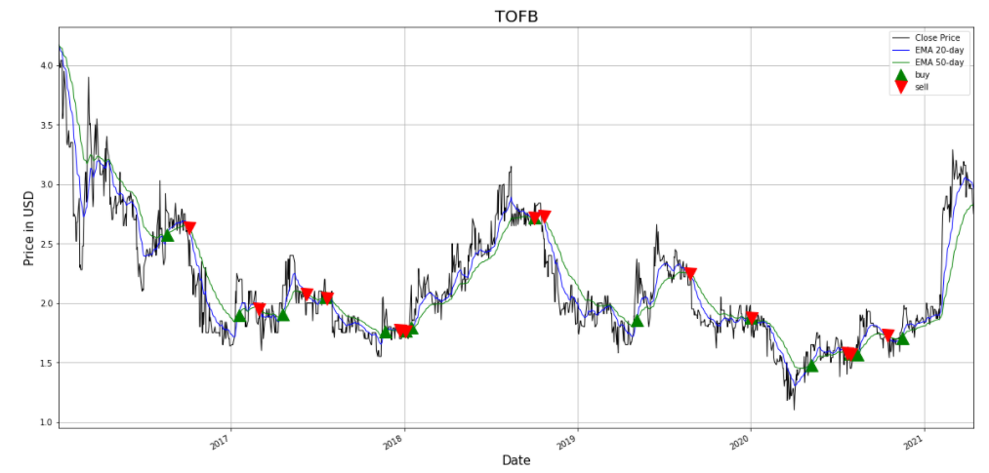
Exponential Moving Average
It’s a type of Moving Average(MA) that places greater weight and significance on the recent data points.
The exponential Moving average is also referred as exponentially weighted average.
EMAs taken over shorter periods of time are more sensitive to prices.
Like all moving averages, this technical indicator is used to produce buy and sell signals based on crossovers and divergences from the historical average.
Often used several EMA lengths are 10-day, 50-day, and 200-day moving averages.

Slide 9
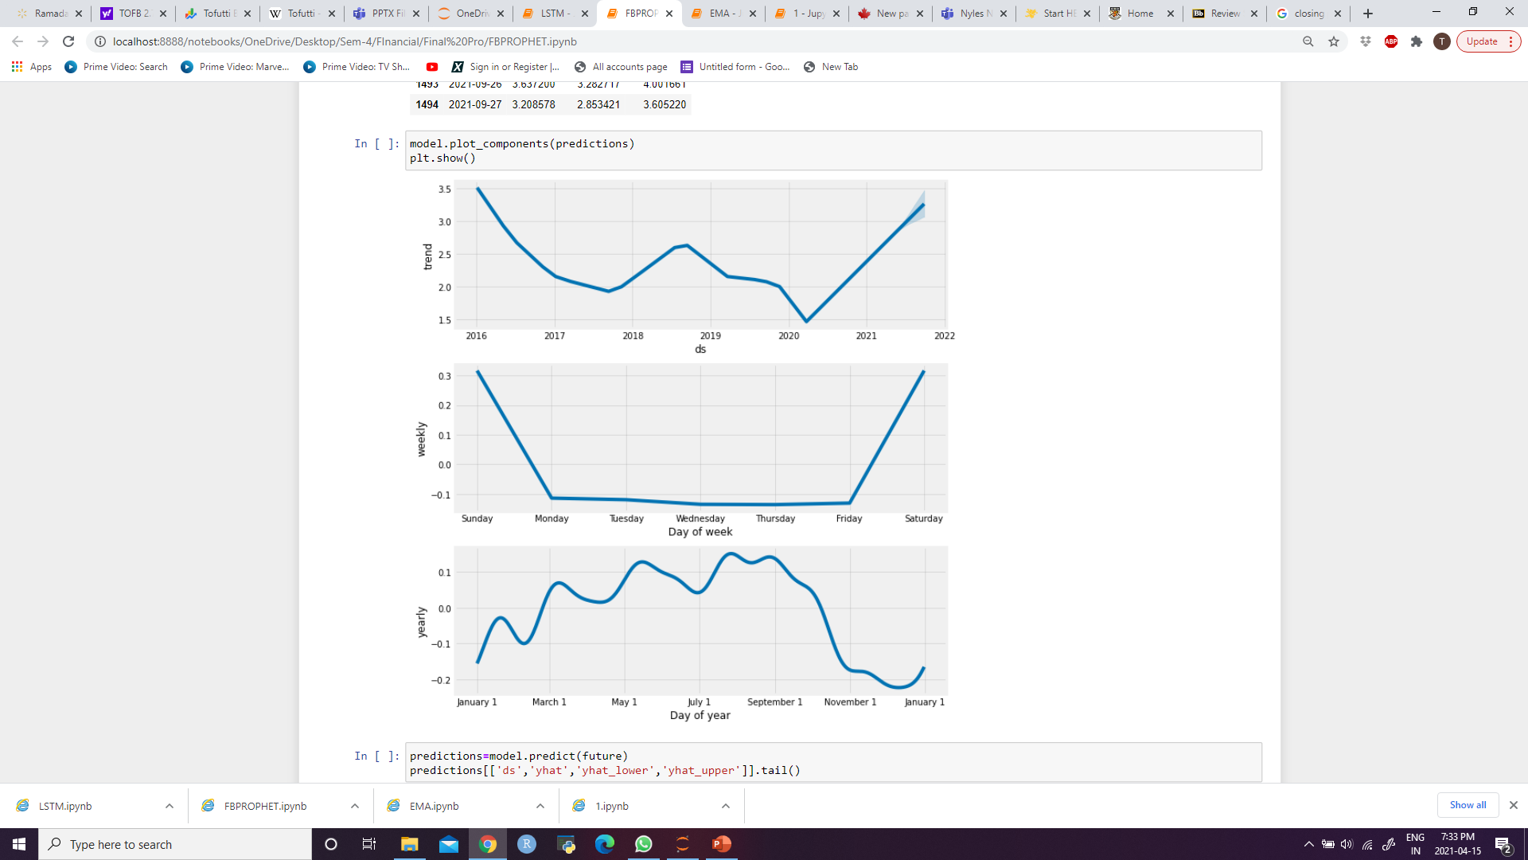
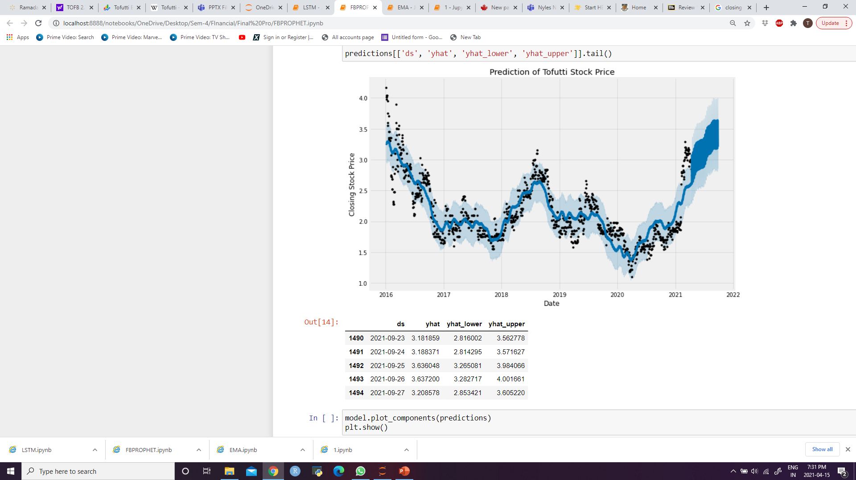
FB PROPHET
Prophet is a procedure for forecasting time series data based on an additive model where non-linear trends are fit with yearly, weekly, and daily seasonality, plus holiday effects.
It works best with time series that have strong seasonal effects and several seasons of historical data.
Prophet is robust to missing data and shifts in the trend, and typically handles outliers well.

Slide 10
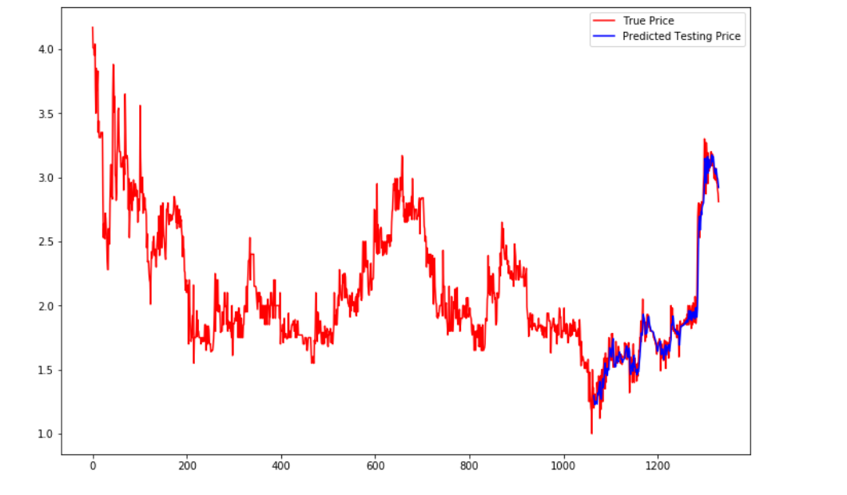
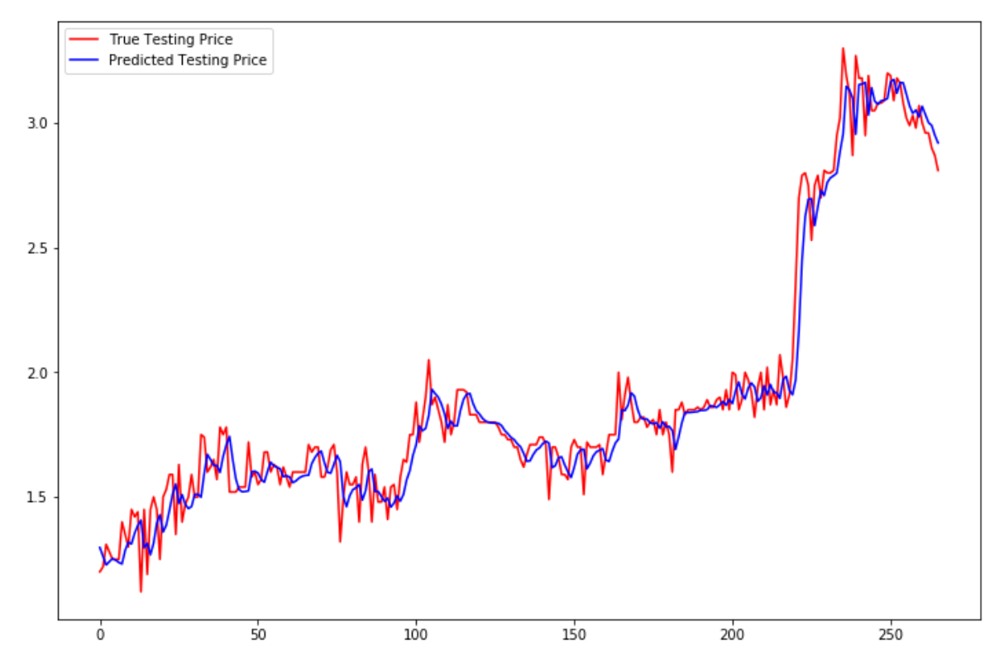
LSTM
Long short-term memory (LSTM) is an artificial recurrent neural network architecture used in the field of deep learning, taking entire sequence of dataset.
LSTM networks are well-suited for classifying, processing and making predictions based on time-series data.

Slide 11
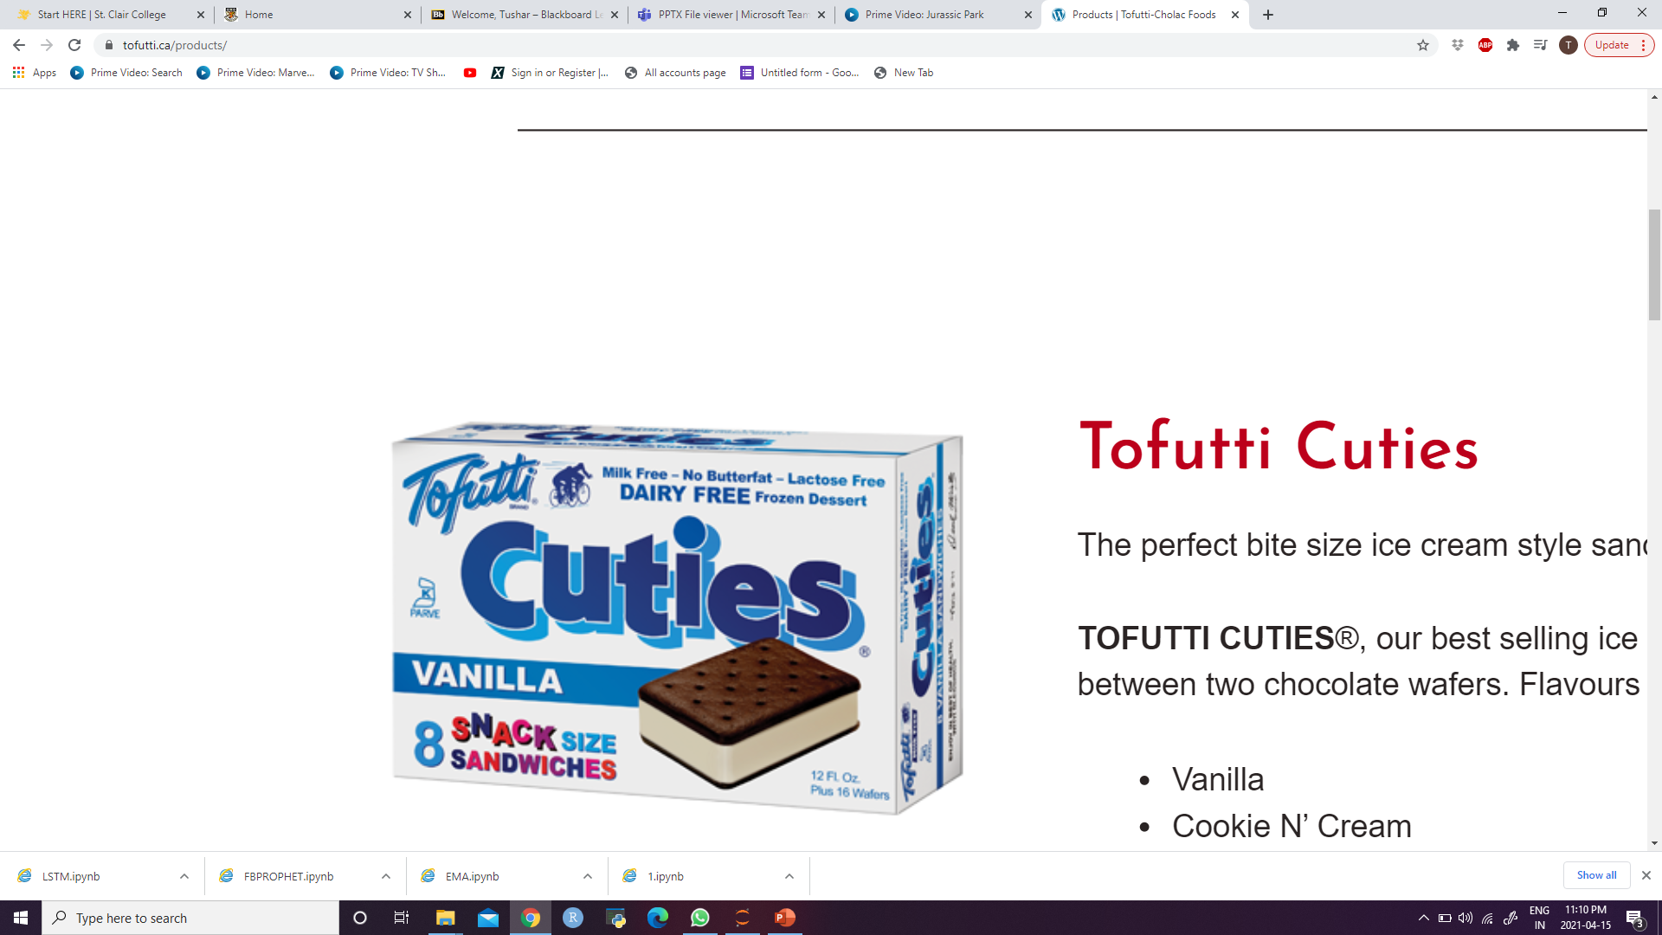
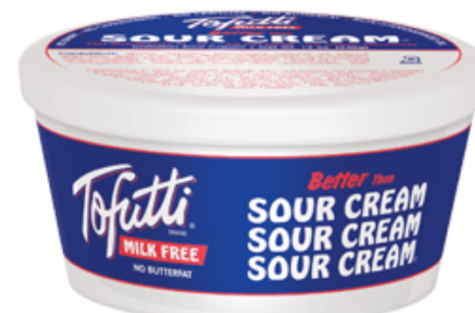
Conclusion
After studying all the forecasting techniques and their graphs we can conclude that the stock base looks promising as it was rising in the past few years, although overall it got affected last year showing downfall around the month of Jan 2020.
This shows Covid did affect businesses, not just a few industries but major industries like dairy, frozen and dessert industries also came to an edge. Nevertheless, becoming a dairy free and health-conscious brand it may be easy to attractive sensitive customers in these times.
According to investors in March,2020 the stock price fell to $1.36 when Coronavirus reached Pandemic status, recently TOFB shares have increased by 102.2% now closing at $2.750, which makes us realize that people are being health conscious diverted towards a healthy lifestyle.

Slide 12
Thank You

